Slide 1
Primary Data

Slide 2
Introduction
The task of data collection begins after a research problem has been defined and research design/plan chalked out.
While deciding about the method of data collection to be used for the study, the researcher should keep in mind two types of data viz., primary and secondary.
The primary data are those which are collected afresh and for the first time, and thus happen to be original in character.
The secondary data, on the other hand, are those which have already been collected by someone else and which have already been passed through the statistical process.

Slide 3
The researcher would have to decide which sort of data he would be using (thus collecting) for his study and accordingly he will have to select one or the other method of data collection.
The methods of collecting primary and secondary data differ since primary data are to be originally collected, while in case of secondary data the nature of data collection work is merely that of compilation.
We describe the different methods of data collection, with the pros and cons of each method.

Slide 4
Sensors
Measurements
Observations
Interviews
Surveys
TYPES OF PRIMARY DATA
Experiments
User Input
Transactions
Process Data
Geographical Data
Machine Data
Event Data

Slide 5
COLLECTION OF PRIMARY DATA
We collect primary data during the course of doing experiments in an experimental research but in case we do research of the descriptive type and perform surveys, whether sample surveys or census surveys, then we can obtain primary data either through observation or through direct communication with respondents in one form or another or through personal interviews.
This, in other words, means
An experiment refers to an investigation in which a factor or variable under test is isolated and its effect(s) measured.
In an experiment the investigator measures the effects of an experiment which he conducts intentionally.
Survey refers to the method of securing information concerning a phenomena under study from all or a selected number of respondents of the concerned universe.
In a survey, the investigator examines those phenomena which exist in the universe independent of his action. The difference between an experiment and a survey can be depicted as under:

Slide 6
There are several methods of collecting primary data, particularly in surveys and descriptive researches.
Important ones are:
Observation method,
Interview method,
Through questionnaires,
Through schedules,
Other methods which include
Warranty cards;
Distributor audits;
Pantry audits;
Consumer panels;
Using mechanical devices;
Through projective techniques;
Depth interviews,
Content analysis.
We briefly take up each method separately.

Slide 7
1. Observation Method
The observation method is the most commonly used method specially in studies relating to behavioral sciences.
In a way we all observe things around us, but this sort of observation is not scientific observation.
Observation becomes a scientific tool and the method of data collection for the researcher, when it serves a formulated research purpose, is systematically planned and recorded and is subjected to checks and controls on validity and reliability.
Under the observation method, the information is sought by way of investigator’s own direct observation without asking from the respondent.

Slide 8
For instance, in a study relating to consumer behavior, the investigator instead of asking the brand of wrist watch used by the respondent, may himself look at the watch.
The main advantage of this method is that subjective bias is eliminated, if observation is done accurately.
Secondly, the information obtained under this method relates to what is currently happening; it is not complicated by either the past behavior or future intentions or attitudes.
Thirdly, this method is independent of respondents’ willingness to respond and as such is relatively less demanding of active cooperation on the part of respondents as happens to be the case in the interview or the questionnaire method.
This method is particularly suitable in studies which deal with subjects (i.e., respondents) who are not capable of giving verbal reports of their feelings for one reason or the other

Slide 9
2. Interview Method
The interview method of collecting data involves presentation of oral-verbal stimuli and reply in terms of oral-verbal responses. This method can be used through personal interviews and, if possible, through telephone interviews.
Personal interviews: Personal interview method requires a person known as the interviewer asking questions generally in a face-to-face contact to the other person or persons. (At times the interviewee may also ask certain questions and the interviewer responds to these, but usually the interviewer initiates the interview and collects the information.)
This sort of interview may be in the form of direct personal investigation or it may be indirect oral investigation.
In the case of direct personal investigation the interviewer has to collect the information personally from the sources concerned.

Slide 10
(b) Telephone interviews: This method of collecting information consists in contacting respondents on telephone itself. It is not a very widely used method, but plays important part in industrial surveys, particularly in developed regions. The chief merits of such a system are:
It is more flexible in comparison to mailing method.
It is faster than other methods i.e., a quick way of obtaining information.
It is cheaper than personal interviewing method; here the cost per response is relatively low.
Recall is easy; callbacks are simple and economical.
There is a higher rate of response than what we have in mailing method; the non-response is generally very low.
Replies can be recorded without causing embarrassment to respondents.
Interviewer can explain requirements more easily.
No field staff is required.
Representative and wider distribution of sample is possible

Slide 11
3. Collection of data through questionnaires
This method of data collection is quite popular, particularly in case of big enquiries.
It is being adopted by private individuals, research workers, private and public organizations and even by governments.
In this method a questionnaire is sent (usually by post) to the persons concerned with a request to answer the questions and return the questionnaire.
A questionnaire consists of a number of questions printed or typed in a definite order on a form or set of forms.
The questionnaire is mailed to respondents who are expected to read and understand the questions and write down the reply in the space meant for the purpose in the questionnaire itself.
The respondents have to answer the questions on their own.

Slide 12
The merits claimed on behalf of this method are as follows | The main demerits of this system can also be listed here:
There is low cost even when the universe is large and is widely spread geographically. | Low rate of return of the duly filled in questionnaires; bias due to no-response is often indeterminate.
It is free from the bias of the interviewer; answers are in respondents’ own words. | It can be used only when respondents are educated and cooperating.
Respondents have adequate time to give well thought out answers. | The control over questionnaire may be lost once it is sent.
Respondents, who are not easily approachable, can also be reached conveniently. | There is inbuilt inflexibility because of the difficulty of amending the approach once questionnaires have been dispatched.
Large samples can be made use of and thus the results can be made more dependable and reliable. | There is also the possibility of ambiguous replies or omission of replies altogether to certain questions; interpretation of omissions is difficult.
 | It is difficult to know whether willing respondents are truly representative.
 | This method is likely to be the slowest of all

Slide 13
Before using this method, it is always advisable to conduct ‘pilot study’ (Pilot Survey) for testing the questionnaires. In a big enquiry the significance of pilot survey is felt very much.
Pilot survey is in fact the replica and rehearsal of the main survey. Such a survey, being conducted by experts, brings to the light the weaknesses (if any) of the questionnaires and also of the survey techniques. From the experience gained in this way, improvement can be effected.
Main aspects of a questionnaire:
Quite often questionnaire is considered as the heart of a survey operation.
Hence it should be very carefully constructed.
If it is not properly set up, then the survey is bound to fail.
This fact requires us to study the main aspects of a questionnaire viz., the general form, question sequence and question formulation and wording.
Researcher should note the following with regard to these three main aspects of a questionnaire:
General form
Question sequence
Question formulation and wording

Slide 14
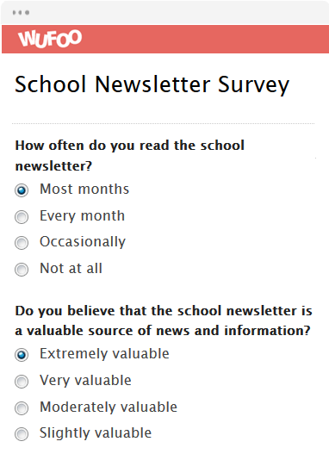
General form:
So far as the general form of a questionnaire is concerned, it can either be structured or unstructured questionnaire.
Structured questionnaires are those questionnaires in which there are definite, concrete and pre-determined questions.
The questions are presented with exactly the same wording and in the same order to all respondents.
Resort is taken to this sort of standardization to ensure that all respondents reply to the same set of questions.
The form of the question may be either closed (i.e., of the type ‘yes’ or ‘no’) or open (i.e., inviting free response) but should be stated in advance and not constructed during questioning.

Slide 15
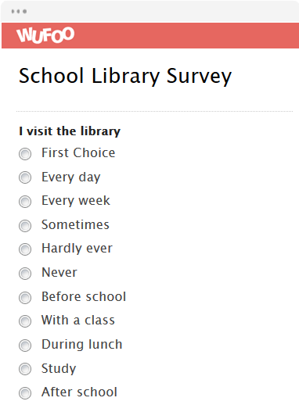
Structured questionnaires may also have fixed alternative questions in which responses of the informants are limited to the stated alternatives.
Thus a highly structured questionnaire is one in which all questions and answers are specified and comments in the respondent’s own words are held to the minimum.
When these characteristics are not present in a questionnaire, it can be termed as unstructured or non-structured questionnaire.
More specifically, we can say that in an unstructured questionnaire, the interviewer is provided with a general guide on the type of information to be obtained, but the exact question formulation is largely his own responsibility and the replies are to be taken down in the respondent’s own words to the extent possible; in some situations tape recorders may be used to achieve this goal.

Slide 16
2. Question sequence:
In order to make the questionnaire effective and to ensure quality to the replies received, a researcher should pay attention to the question-sequence in preparing the questionnaire.
A proper sequence of questions reduces considerably the chances of individual questions being misunderstood.
The question-sequence must be clear and smoothly-moving, meaning thereby that the relation of one question to another should be readily apparent to the respondent, with questions that are easiest to answer being put in the beginning.
The first few questions are particularly important because they are likely to influence the attitude of the respondent and in seeking his desired cooperation.

Slide 17
The opening questions should be such as to arouse human interest.
The following type of questions should generally be avoided as opening questions in a questionnaire:
1. questions that put too great a strain on the memory or intellect of the respondent;
2. questions of a personal character;
3. questions related to personal wealth, etc.

Slide 18
3. Question formulation and wording:
With regard to this aspect of questionnaire, the researcher should note that each question must be very clear for any sort of misunderstanding can do irreparable harm to a survey.
Question should also be impartial in order not to give a biased picture of the true state of affairs.
Questions should be constructed with a view to their forming a logical part of a well thought out tabulation plan.
In general, all questions should meet the following standards—
(a) Should be easily understood;
(b) Should be simple i.e., should convey only one thought at a time;
(c) Should be concrete and should conform as much as possible to the respondent’s way of thinking.

Slide 19
Concerning the form of questions, we can talk about two principal forms, viz., multiple choice question and the open-end question.
In the former the respondent selects one of the alternative possible answers put to him, whereas in the latter he has to supply the answer in his own words.
The question with only two possible answers (usually ‘Yes’ or ‘No’) can be taken as a special case of the multiple choice question, or can be named as a ‘closed question.’
There are some advantages and disadvantages of each possible form of question.
Multiple choice or closed questions have the advantages of easy handling, simple to answer, quick and relatively inexpensive to analyse.
They are most amenable to statistical analysis.
Sometimes, the provision of alternative replies helps to make clear the meaning of the question.
But the main drawback of fixed alternative questions is that of “putting answers in people’s mouths” i.e., they may force a statement of opinion on an issue about which the respondent does not infact have any opinion.

Slide 20
Essentials of a good questionnaire:
To be successful, questionnaire should be comparatively short and simple i.e., the size of the questionnaire should be kept to the minimum.
Questions should proceed in logical sequence moving from easy to more difficult questions.
Personal and intimate questions should be left to the end.
Technical terms and vague expressions capable of different interpretations should be avoided in a questionnaire.
Questions may be dichotomous (yes or no answers), multiple choice (alternative answers listed) or open-ended.
The latter type of questions are often difficult to analyse and hence should be avoided in a questionnaire to the extent possible.
There should be some control questions in the questionnaire which indicate the reliability of the respondent.
For instance, a question designed to determine the consumption of particular material may be asked

Slide 21
Process of designing a Questionnaire
1. Specify the Information Needed: The first and the foremost step in designing the questionnaire is to specify the information needed from the respondents such that the objective of the survey is fulfilled. The researcher must completely review the components of the problem, particularly the hypothesis, research questions, and the information needed.
2. Define the Target Respondent: At the very outset, the researcher must identify the target respondent from whom the information is to be collected. The questions must be designed keeping in mind the type of respondents under study. Such as, the questions that are appropriate for serviceman might not be appropriate for a businessman. The less diversified respondent group shall be selected because the more diversified the group is, the more difficult it will be to design a single questionnaire that is appropriate for the entire group.

Slide 22
3. Specify the type of Interviewing Method:
The next step is to identify the way in which the respondents are reached. In personal interviews, the respondent is presented with a questionnaire and interacts face-to-face with the interviewer. Thus, lengthy, complex and varied questions can be asked using the personal interview method.
In telephone interviews, the respondent is required to give answers to the questions over the telephone. Here the respondent cannot see the questionnaire and hence this method restricts the use of small, simple and precise questions.
The questionnaire can be sent through mail or post. It should be self-explanatory and contain all the important information such that the respondent is able to understand every question and gives a complete response. The electronic questionnaires are sent directly to the mail ids of the respondents and are required to give answers online.

Slide 23
4. Determine the Content of Individual Questions:
Once the information needed is specified and the interviewing methods are determined, the next step is to decide the content of the question. The researcher must decide on what should be included in the question such that it contribute to the information needed or serve some specific purpose.
In some situations, the indirect questions which are not directly related to the information needed may be asked. It is useful to ask neutral questions at the beginning of a questionnaire with intent to establish respondent’s involvement and rapport. This is mainly done when the subject of a questionnaire is sensitive or controversial.
The researcher must try to avoid the use of double-barreled questions. A question that talks about two issues simultaneously, such as Is the Real juice tasty and a refreshing health drink?

Slide 24
5. Overcome Respondent’s Inability and Unwillingness to Answer:
The researcher should not presume that the respondent can provide accurate responses to all the questions. He must attempt to overcome the respondent’s inability to answer.
The questions must be designed in a simple and easy language such that it is easily understood by each respondent. In situations, where the respondent is not at all informed about the topic of interest, then the researcher may ask the filter questions, an initial question asked in the questionnaire to identify the prospective respondents to ensure that they fulfill the requirements of the sample.
Despite being able to answer the question, the respondent is unwilling to devote time in providing information. The researcher must attempt to understand the reason behind such unwillingness and design the questionnaire in such a way that it helps in retaining the respondent’s attention.

Slide 25
6. Decide on the Question Structure:
The researcher must decide on the structure of questions to be included in the questionnaire. The question can be structured or unstructured. The unstructured questions are the open-ended questions which are answered by the respondents in their own words. These questions are also called as a free-response or free-answer questions.
While, the structured questions are called as closed-ended questions that pre-specify the response alternatives. These questions could be a multiple choice question, dichotomous (yes or no) or a scale.
7. Determine the Question Wording: The desired question content and structure must be translated into words which are easily understood by the respondents. At this step, the researcher must translate the questions in easy words such that the information received from the respondents is similar to what was intended.

Slide 26
In case the question is written poorly, then the respondent might refuse to answer it or might give a wrong answer. In case, the respondent is reluctant to give answers, then “non response” arises which increases the complexity of data analysis. On the other hand, if the wrong information is given, then “ response error” arises due to which the result is biased.
8. Determine the Order of Questions:
At this step, the researcher must decide the sequence in which the questions are to be asked. The opening questions are crucial in establishing respondent’s involvement and rapport, and therefore, these questions must be interesting, non-threatening and easy.
Usually, the open-ended questions which ask respondents for their opinions are considered as good opening questions, because people like to express their opinions.

Slide 27
9. Identify the Form and Layout: The format, positioning and spacing of questions has a significant effect on the results. The layout of a questionnaire is specifically important for the self-administered questionnaires. The questionnaires must be divided into several parts, and each part shall be numbered accurately to clearly define the branches of a question.
10. Reproduction of Questionnaire: Here, we talk about the appearance of the questionnaire, i.e. the quality of paper on which the questionnaire is either written or printed. In case, the questionnaire is reproduced on a poor-quality paper; then the respondent might feel the research is unimportant due to which the quality of response gets adversely affected.
Thus, it is recommended to reproduce the questionnaire on a good-quality paper having a professional appearance. In case, the questionnaire has several pages, then it should be presented in the form of a booklet rather than the sheets clipped or stapled together.

Slide 28
11. Pretesting:
Pretesting means testing the questionnaires on a few selected respondents or a small sample of actual respondents with a purpose of improving the questionnaire by identifying and eliminating the potential problems.
All the aspects of the questionnaire must be tested such as question content, structure, wording, sequence, form and layout, instructions, and question difficulty. The researcher must ensure that the respondents in the pretest should be similar to those who are to be finally surveyed.

Slide 29
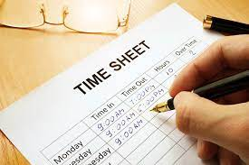
4. Collection of data through schedules
This method of data collection is very much like the collection of data through questionnaire, with little difference which lies in the fact that schedules (proforma containing a set of questions) are being filled in by the enumerators who are specially appointed for the purpose.
These enumerators along with schedules, go to respondents, put to them the questions from the Performa in the order the questions are listed and record the replies in the space meant for the same in the Performa.

Slide 30
In certain situations, schedules may be handed over to respondents and enumerators may help them in recording their answers to various questions in the said schedules.
Enumerators explain the aims and objects of the investigation and also remove the difficulties which any respondent may feel in understanding the implications of a particular question or the definition or concept of difficult terms.
This method requires the selection of enumerators for filling up schedules or assisting respondents to fill up schedules and as such enumerators should be very carefully selected.
The enumerators should be trained to perform their job well and the nature and scope of the investigation should be explained to them thoroughly so that they may well understand the implications of different questions put in the schedule.
Enumerators should be intelligent and must possess the capacity of cross examination in order to find out the truth. Above all, should be honest, sincere, hardworking and should have patience and perseverance.

Slide 31
Difference between Questionnaires and Schedules
Both questionnaire and schedule are popularly used methods of collecting data in research surveys.
There is much resemblance in the nature of these two methods and this fact has made many people to remark that from a practical point of view, the two methods can be taken to be the same.
But from the technical point of view there is difference between the two.
The important points of difference are as under:
The questionnaire is generally sent through mail to informants to be answered as specified in a covering letter, but otherwise without further assistance from the sender. The schedule is generally filled out by the research worker or the enumerator, who can interpret questions when necessary.

Slide 32
To collect data through questionnaire is relatively cheap and economical since we have to spend money only in preparing the questionnaire and in mailing the same to respondents. Here no field staff required. To collect data through schedules is relatively more expensive since considerable amount of money has to be spent in appointing enumerators and in importing training to them. Money is also spent in preparing schedules.
Non-response is usually high in case of questionnaire as many people do not respond and many return the questionnaire without answering all questions. Bias due to non-response often remains indeterminate. As against this, non-response is generally very low in case of schedules because these are filled by enumerators who are able to get answers to all questions. But there remains the danger of interviewer bias and cheating.

Slide 33
In case of questionnaire, it is not always clear as to who replies, but in case of schedule the identity of respondent is known.
The questionnaire method is likely to be very slow since many respondents do not return the questionnaire in time despite several reminders, but in case of schedules the information is collected well in time as they are filled in by enumerators.
Personal contact is generally not possible in case of the questionnaire method as questionnaires are sent to respondents by post who also in turn return the same by post. But in case of schedules direct personal contact is established with respondents.
Questionnaire method can be used only when respondents are literate and cooperative, but in case of schedules the information can be gathered even when the respondents happen to be illiterate.

Slide 34
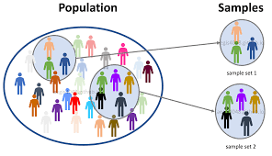
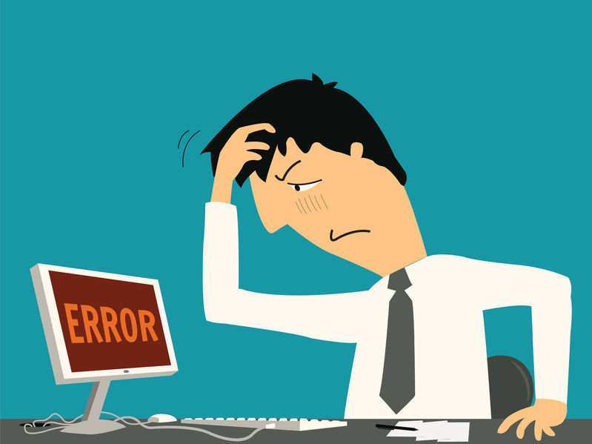
Wider and more representative distribution of sample is possible under the questionnaire method, but in respect of schedules there usually remains the difficulty in sending enumerators over a relatively wider area.
Risk of collecting incomplete and wrong information is relatively more under the questionnaire method, particularly when people are unable to understand questions properly. But in case of schedules, the information collected is generally complete and accurate as enumerators can remove the difficulties, if any, faced by respondents in correctly understanding the questions. As a result, the information collected through schedules is relatively more accurate than that obtained through questionnaires.

Slide 35
The success of questionnaire method lies more on the quality of the questionnaire itself, but in the case of schedules much depends upon the honesty and competence of enumerators.
In order to attract the attention of respondents, the physical appearance of questionnaire must be quite attractive, but this may not be so in case of schedules as they are to be filled in by enumerators and not by respondents.
Along with schedules, observation method can also be used but such a thing is not possible while collecting data through questionnaires.

Slide 36
5. Some Other Methods of Data Collection
Let us consider some other methods of data collection, particularly used by big business houses in modern times.
1. Warranty cards: Warranty cards are usually postal sized cards which are used by dealers of consumer durables to collect information regarding their products. The information sought is printed in the form of questions on the ‘warranty cards’ which is placed inside the package along with the product with a request to the consumer to fill in the card and post it back to the dealer.

Slide 37
2. Distributor (or) Store Audits: Distributor or store audits are performed by distributors as well as manufactures through their salesmen at regular intervals. Distributors get the retail stores audited through salesmen and use such information to estimate market size, market share, seasonal purchasing pattern and so on.
The data are obtained in such audits not by questioning but by observation. For instance, in case of a grocery store audit, a sample of stores is visited periodically and data are recorded on inventories on hand either by observation or copying from store records.
Store audits are invariably panel operations, for the derivation of sales estimates and compilation of sales trends by stores are their principal ‘raison deter’. The principal advantage of this method is that it offers the most efficient way of evaluating the effect on sales of variations of different techniques of in-store promotion.

Slide 38
Pantry Audits: Pantry audit technique is used to estimate consumption of the basket of goods at the consumer level. In this type of audit, the investigator collects an inventory of types, quantities and prices of commodities consumed. Thus in pantry audit data are recorded from the examination of consumer’s pantry.
The usual objective in a pantry audit is to find out what types of consumers buy certain products and certain brands, the assumption being that the contents of the pantry accurately portray consumer’s preferences.
A pantry audit may or may not be set up as a panel operation, since a single visit is often considered sufficient to yield an accurate picture of consumers’ preferences.

Slide 39
4. Consumer panels:
An extension of the pantry audit approach on a regular basis is known as ‘consumer panel’, where a set of consumers are arranged to come to an understanding to maintain detailed daily records of their consumption and the same is made available to investigator on demands.
In other words, a consumer panel is essentially a sample of consumers who are interviewed repeatedly over a period of time. Mostly consume panels are of two types viz.,
The transitory consumer panel
The continuing consumer panel.

Slide 40
A transitory consumer panel is set up to measure the effect of a particular phenomenon. Usually such a panel is conducted on a before-and-after-basis. Initial interviews are conducted before the phenomenon takes place to record the attitude of the consumer. A second set of interviews is carried out after the phenomenon has taken place to find out the consequent changes that might have occurred in the consumer’s attitude. It is a favorite tool of advertising and of social research.
A continuing consumer panel is often set up for an indefinite period with a view to collect data on a particular aspect of consumer behavior over time, generally at periodic intervals or may be meant to serve as a general purpose panel for researchers on a variety of subjects. Such panels have been used in the area of consumer expenditure, public opinion and radio and TV listenership

Slide 41
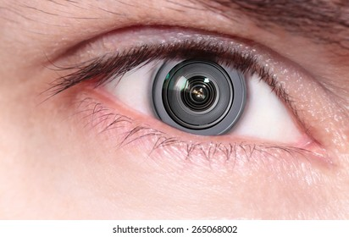
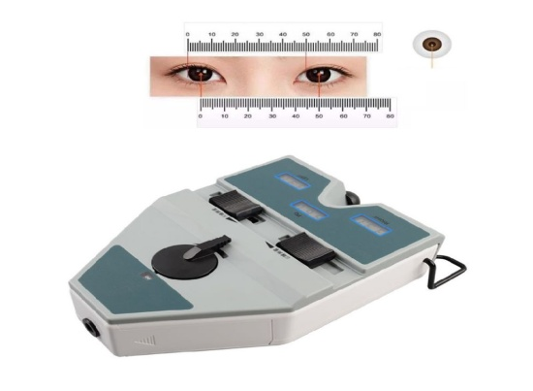
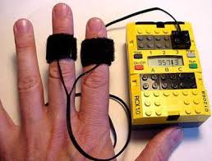
5. Use of mechanical devices:
The use of mechanical devices has been widely made to collect information by way of indirect means.
Eye camera - Eye cameras are designed to record the focus of eyes of a respondent on a specific portion of a sketch or diagram or written material. Such an information is useful in designing advertising material.
Pupil metric camera, - Pupil metric cameras record dilation of the pupil as a result of a visual stimulus. The extent of dilation shows the degree of interest aroused by the stimulus.
Psycho galvanometer, - Psycho galvanometer is used for measuring the extent of body excitement as a result of the visual stimulus.

Slide 42
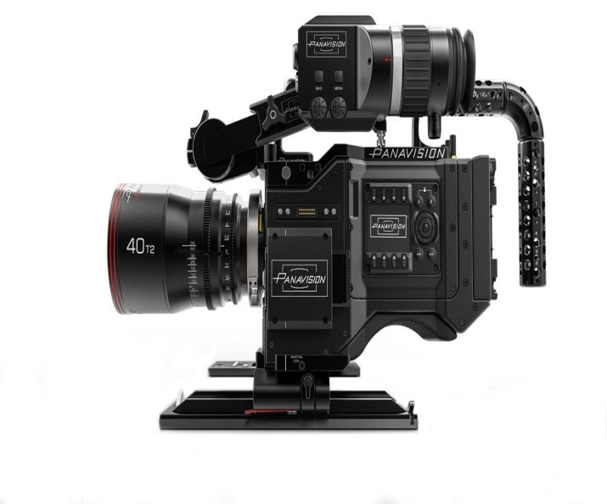
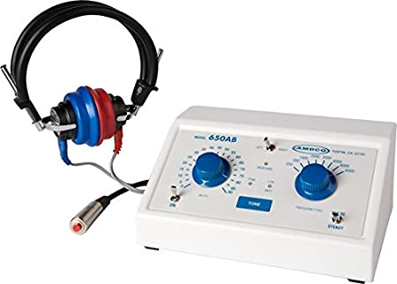
Motion picture camera - Motion picture cameras can be used to record movement of body of a buyer while deciding to buy a consumer good from a shop or big store. Influence of packaging or the information given on the label would stimulate a buyer to perform certain physical movements which can easily be recorded by a hidden motion picture camera in the shop’s four walls.
Audiometer are the principal devices so far developed and commonly used by modern big business houses, mostly in the developed world for the purpose of collecting the required information. Audiometers are used by some TV concerns to find out the type of programmes as well as stations preferred by people. A device is fitted in the television instrument itself to record these changes. Such data may be used to find out the market share of competing television stations.

Slide 43
6. Projective techniques:
Projective techniques (or what are sometimes called as indirect interviewing techniques) for the collection of data have been developed by psychologists to use projections of respondents for inferring about underlying motives, urges, or intentions which are such that the respondent either resists to reveal them or is unable to figure out himself. In projective techniques the respondent in supplying information tends unconsciously to project his own attitudes or feelings on the subject under study. Projective techniques play an important role in motivational researches or in attitude surveys.

Slide 44
We may now briefly deal with the important projective techniques.
Word association tests
Sentence completion tests
Story completion tests
Verbal projection tests
Pictorial techniques
Thematic apperception test
Rosenzweig test
Rorschach test
Holtzman Inkblot Test
Tomkins-Horn picture arrangement test
Play techniques
Quizzes, tests and examinations
Sociometry

Slide 45
7. Depth interviews:
Depth interviews are those interviews that are designed to discover underlying motives and desires and are often used in motivational research.
Such interviews are held to explore needs, desires and feelings of respondents.
In other words, they aim to elicit unconscious as also other types of material relating especially to personality dynamics and motivations.
As such, depth interviews require great skill on the part of the interviewer and at the same time involve considerable time.
Unless the researcher has specialized training, depth interviewing should not be attempted.

Slide 46
8. Content-analysis:
Content-analysis consists of analyzing the contents of documentary materials such as books, magazines, newspapers and the contents of all other verbal materials which can be either spoken or printed.
Content-analysis prior to 1940’s was mostly quantitative analysis of documentary materials certain characteristics that can be identified and counted.
But since 1950’s content-analysis is mostly qualitative analysis concerning the general import or message of the existing documents.
Content analysis measures pervasiveness and that is sometimes an index of the intensity of the force.

Slide 47
MERITS AND LIMITATIONS OF PRIMARY DATA
Merits
Degree of accuracy is quite high.
It does not require extra caution.
It depicts the data in great detail.
Primary source of data collection frequently includes definitions of various! and units used.
For some investigations, secondary data are not available.
Demerits
Collection of data requires a lot of time.
It requires lot of finance.
In some enquiries it is not possible to collect primary data.
It requires a lot of labour.
It requires a lot of skill.

